Slide 1
Term Project Iteration 2 Walkthrough

Slide 2
Iteration 2 Components
Structural Database Rules
You define structural database rules which formally specify the entities, relationships, and constraints for your database design.
Conceptual Entity Relationship Diagram
You create an initial ERD, the universally accepted method of modeling and visualizing database designs, to visualize the entities and relationships defined by the structural database rules.

Slide 3
Entity Relationship Diagramming

Slide 4

Relational Database Limitation
Notes:
While relational databases have many strengths, one if their most significant weaknesses is the inability to convey real-world semantics (i.e. real-world meaning).

Slide 5
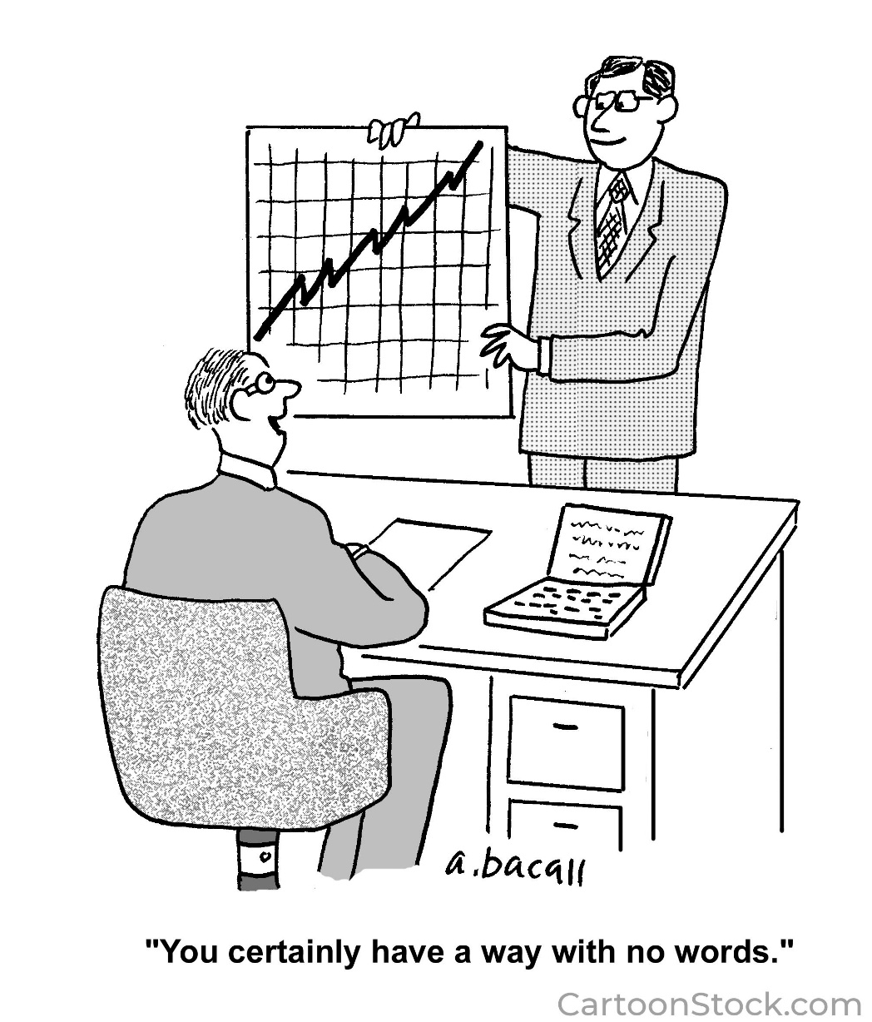
Entity Relationship Diagrams
Notes:
Entity Relationship Diagrams (ERDs) and the underlying entity-relationship model were first envisioned and documented by Peter Chen in the late 1970s to address this exact problem.
Chen envisioned that ERDs would be used to model the data, and then the relational database representation would be derived from the ERD (Chen, 1976).
Entity relationship diagrams are now the universally accepted way of visualizing relational databases.

Slide 6
Entities
Entity relationship diagrams at the highest level let us model entities.
An entity is a type, a blueprint which defines the structure for all of its instances

Slide 7
Attributes
Attributes describe entities.
Attributes have a datatype.
Attributes in the relational model may only contain a single value.

Slide 8
Entity Instance
An entity instance is a realization of the blueprint defined by the entity.

Slide 9
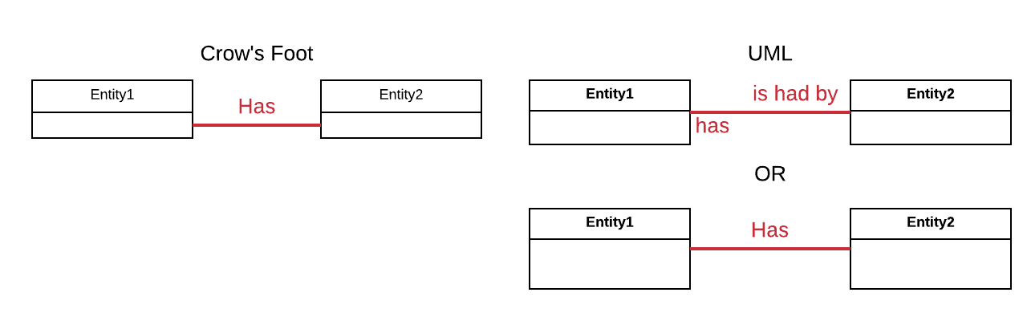
Associative Relationship Existence
Notes:
Associative relationships allow an entity instance from one entity to be related to one or more entity instances.
When a relationship is established between entities, it allows entity instance from one entity to be related to one or more entity instances from another entity.

Slide 10
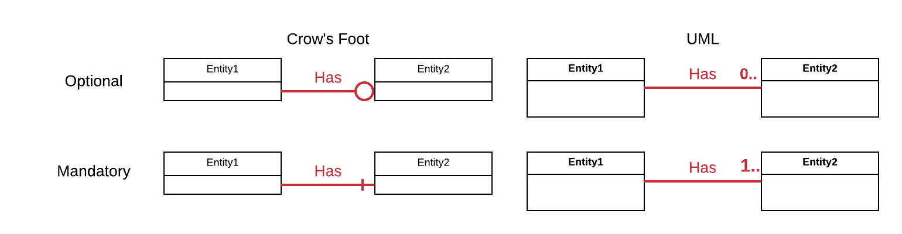
Participation Constraint

Slide 11
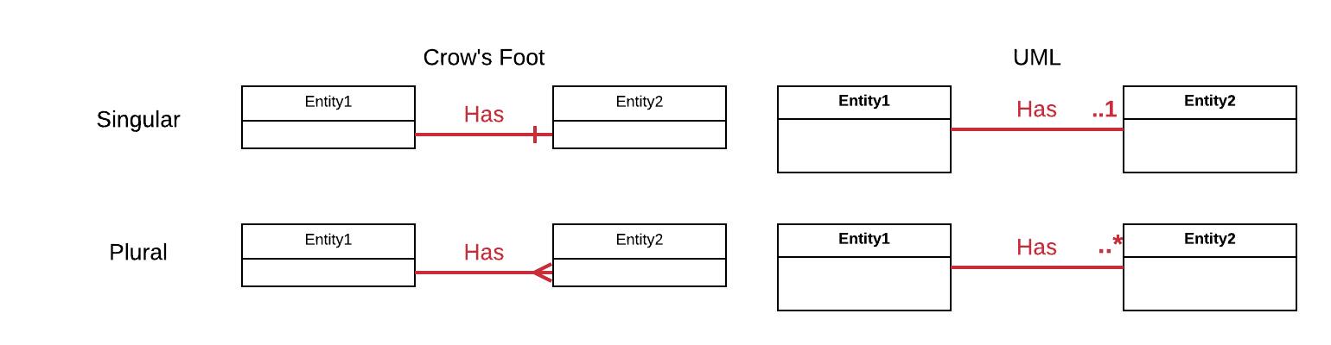
Plurality Constraint

Slide 12
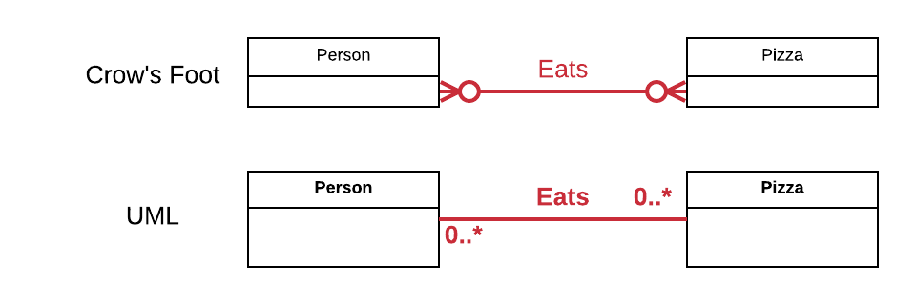
Full Example
Notes:
Each person may eat many pizzas; each pizza may be eaten by many people.

Slide 13
Relationship Degrees
The degree of the relationship indicates the number of entities which participate in the relationship.
Most of the time, a relationship is between two entities, and so it has a degree of two.

Slide 14
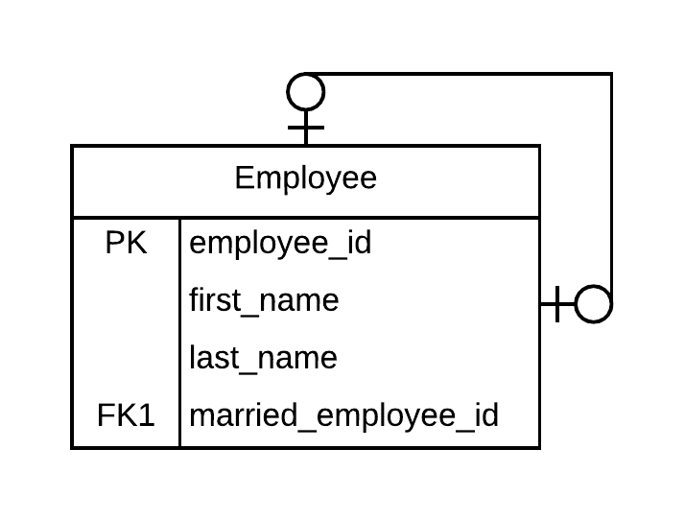
Recursive Relationships
In a recursive relationship, an entity is related to itself.

Slide 15
ERD Layers
Conceptual
Contains the entities and relationships we see in our minds.
Independent of any implementation model (relational or otherwise).
Logical
Implements the entities and relationships we see in our minds in the relational model.
Independent of any particular database.
DBMS Physical
Implements the logical model for a particular database such as Oracle 18c or SQL Server 2017.
Contains database-specific properties.

Slide 16
Associative Structural Database Rules

Slide 17

Organizational Analysis
Notes:
When an application or I.T. system is being created for an organization, careful analysis of the organization and its processes results in a formal description of their operation.
Business rules, domain models, use cases, and other artifacts are created during this process.

Slide 18
Component Design
Each application component has its own set of concerns and technologies.
Security specialists create quite specific security requirements.
Application programmers create UML diagrams such as class diagrams and sequence diagrams.
Database designers create structural database rules to describe how the database will be designed.

Slide 19

Enforcement in the Database
Notes:
From a relational database perspective, an operational rule supported by an application can be enforced three ways:
enforced with table structure, relationships, and/or SQL constraints (structural enforcement)
enforced with data (data-driven enforcement)
enforced programmatically through advanced DBMS abilities such as stored procedures and triggers, or through an application (programmatic enforcement)

Slide 20
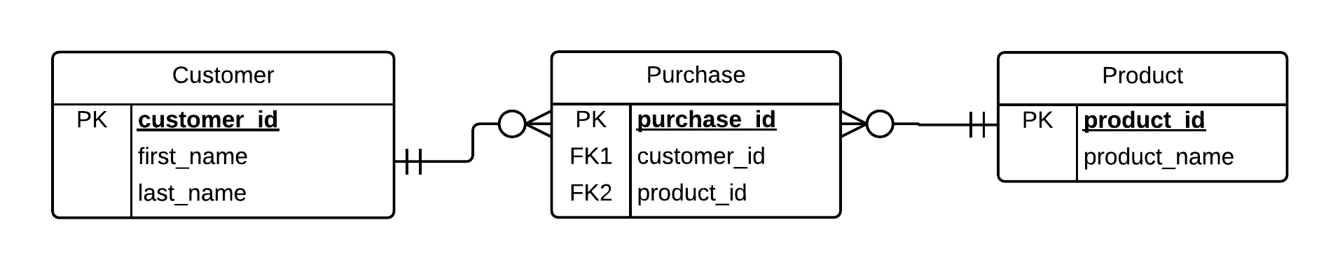
Structural Enforcement
We prefer to enforce operational rules structurally when possible.
When a operational rules are enforced structurally, it is either impossible to violate the rule because of the table design, or the SQL constraints cause immediate rejection of any violation at the SQL statement level.
Example: “A customer may purchase many products; each product may be purchased by many customers.”

Slide 21
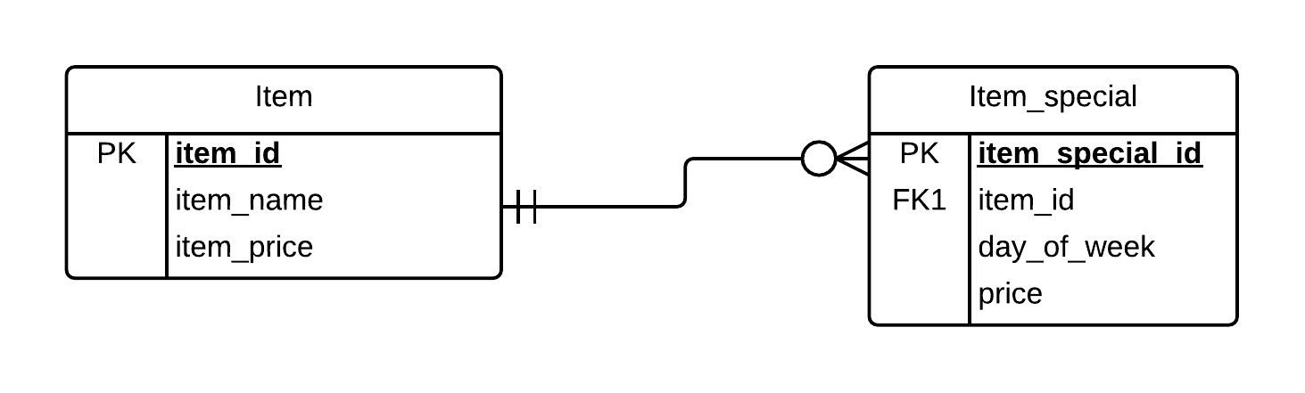
Data-Driven Enforcement
Some operational rules either cannot be enforced structurally, or are expected to change regularly, and can be enforced with data.
Example: “The price of pizza is $7.99 on Wednesdays”.
We expect such specials to change over time.
We can setup a design whereby specials can be implemented and changed with data.

Slide 22
Programmatic Enforcement
Some operational rules are too complex or advanced to be enforced with structure or data, and can be enforced programmatically.
Example: “The price of a new food item cannot exceed the average price of the three most expensive food items, over the last year, by more than $2.”
We expect the data and the methodology the data to change over time.
We use some programming language, whether internal or external to the database, to enforce the rule.

Slide 23
When to Use
Structural
Methodology (algorithm) and specifics (data values) unlikely to change
Data-driven
Methodology unlikely to change, specifics likely to change
Programmatic
Methodology and specifics likely to change
Most Preferred
Least Preferred

Slide 24
Associative Structural Database Format
Structural enforcement of operational rules results in structural database rules.
Each associative structural database rule specifies two entities, a relationship between the entities, participation constraints on both sides of the relationship, and plurality constraints on both sides of the relationship.
ERDs are created from structural database rules.

Slide 25
Structural Database Rule Examples
A customer (entity1) may (participation constraint) purchase (relationship) many (plurality constraint) products (entity2); each product (entity2) can (participation constraint) be purchased (relationship) by many (plurality constraint) customers (entity1).
A person (entity1) may (participation) own (relationship) many (plurality) shoes (entity2); each shoe (entity2) is (participation) owned (relationship) by a (plurality) person (entity1).

Slide 26
Structural Database Rules Summary
Every organization operates according to a set of rules, and we start the process of creating our application by analyzing the organization and its processes.
We formerly model the organization and its processes by creating business rules, each of which defines or constrains an aspect of the organization’s structure or process, and other artifacts.
We can phrase structural database rules them in many different ways, but the entities, relationship, and constraints must be entirely unambiguous.

Slide 27
Structural Rules Tip #1
Do you need to have two pairs of sentences to represent the relationship between two entities?
YES. The lack of an explicit business rule in one direction indicates there IS something missing.
EXAMPLE
GIVEN: “A book is published in a year” – BOOK – to – YEAR
NOT GIVEN: A rule to describe YEAR – to – BOOK.
The lack of the 2nd rule requires further analysis. Can a year be related to many books or just one? Can a year be related to no books at all?
What to do?
Always write structural rules as pairs of sentences, one sentence for each direction. This removes ambiguity.

Slide 28
Structural Rules Tip #2
Can a structural business rule describe the relationship between more than two entities?
A structural business rule should only describe the relationship between TWO entities.
EXAMPLE OF WHAT NOT TO DO
“A child may have multiple appointments with multiple pediatricians in the clinic”
The relationship from CHILD – to- APPOINTMENT is clear, but APPOINTMENT – to- PEDIATRICIAN is unclear.
Break into two rule pairs.
A child may have multiple appointments; each appointment is for one child.
Each appointment is attended a pediatrician; each pediatrician may attend many appointments.

Slide 29
Structural Rules Tip #3
Should the entity being described be singular or plural?
A structural database rule should always start from the perspective of ONE of the first entity (first entity is always singular).
BAD: “Multiple appointments are attended by physicians”
GOOD: “An appointment is attended by a physician.”

Slide 30
Associative Demo

Slide 31
Structural Rules Evaluation
Structure of Rules (15%) | This measures how well-formed and unambiguous the structural database rules are. | Entirely well-formed Entirely unambiguous
Sufficiency of Entities (15%) | This measures how well the entities support the most important aspects of the database. | Entirely support
Sufficiency of Relationships (15%) | This measures how well the relationships support the most important aspects of the database. | Entirely support
Accuracy of Relationship Constraints (15%) | This measures how accurate and useful the participation and plurality constraints are given the needs of the database. | Entirely accurate Entirely useful

Slide 32
ERD Evaluation
Entity Relationship Diagram Soundness (20%) | This measures how well the ERD reflects the structural database rules, and the correctness of the diagrammatic notation. | Entirely reflects rules Entirely correct diagrammatic notation

Slide 33
Overall Evaluation
Overall Presentation (10%) | This measures how well the choices for the structural database rules, entities, relationships, constraints, the ERD, and other design aspects are supported with explanations, in addition to the documentation organization and presentation. | Excellent support Well organized and presented
Prior Work Soundness (10%) | This measures how well any issues from prior iterations have been improved in order to provide a frame of reference for this iteration. | Completely improved or No improvement necessary
Number of Entities | At least 8 are required 3 point deduction for each missing
Lateness Deduction | 5 points per day 4 days maximum Contact your facilitator for any exceptions

Slide 34
Works Cited
Chen, P. (1976). The Entity Relationship Model – Toward a Unified View of Data. ACM Transactions on Database Systems, 1.

